Slide 1

Wanderlust Tourism
Anish Kapuskar
Akshay Mahajanshetti
Vaibhav Raj
Tanishka Porwal
Ashwin Agarkhed

Slide 2



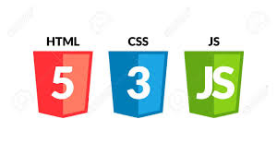
Technologies Used

Slide 3
Project Idea
Wanderlust Tourism
This platform allows users to explore different travel locations as well as adventures like Sky diving, beaches and beautiful cities of the world. User can login and compare all the different packages, and buy the holiday packages from our website.

Slide 4

Features
Session Management (JWT)
Social Media Logins
Pdf Generation
Password Encryption
Current weather condition
PayPal – for easy payments

Slide 5
Demo!

